Slide 1

ReactJS Practice One Review
Developer: Ba Thanh Nguyen
Mentor: Quyen Huynh
Supporter: Huy Pham

Slide 2




TECHNICAL
HTML5
CSS3
JAVASCRIPT
React

Slide 3

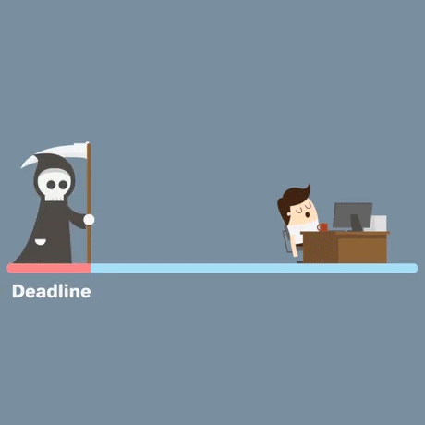
TIMELINE
10 days ( 2022/09/09 – 2022/10/05)

Slide 4

TEAM SIZE
1 DEV

Slide 5

TARGETS
This practice will let you understand simple flow in React
Build simple apps for product management using React.
Understand & apply knowledge of ReactJS (Define component, State, props, JSX, Handle event, Render elements ).
Understanding & applying React Hooks

Slide 6

REQUIREMENTS
Create mocking data:
Render the list of products.
Search products by name:
Users can search for products by typing the product name in the search bar.
Create A New Product:
The user can add a new product by name and link image- Open the form to add a new one.
Delete the product in the list:
The user can delete the product when clicking the Delete button – Show the confirmation dialog.

Slide 7

ISSUES
The estimated number of working days is not correct.
The time to do React Practice-One is later than expected.
Dividing and creating components is not very well.
The code has not been optimized.

Slide 8

Demo

Slide 9
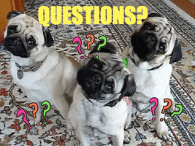
Q & A

Slide 10


